Slide 1


Awakening What's Possible
Optix
Small Tools Inventory Management
Built for Urban Infraconstruction LLC: one trustworthy answer to where every small tool is, and who is holding it.
PREPARED FOR
PRESENTED BY
DATE
Urban Infraconstruction LLC
Bodhi Labs
September 2026

Slide 2















AGENDA — FROM MISSION TO DAILY WORK
1. Mission & Goals
2. How Optix Works
3. Field & Desk
Why Optix exists, and the outcomes it has to prove on Urban's jobs.
One ledger, one writer: how a tool moves and how its location is calculated.
Two layouts — a foreman's phone, and the equipment desk's full working surface.
4. Screens & Features
5. Roles & Screens
6. Doing the Work
Register, custody, tools by jobsite, reports and the audit trail.
Each role mapped to the screens it gets, and what it may do.
Assign a tool, hand over a container, staff a job, onboard a crew.

Slide 3


MISSION & GOALS
Turning tool custody from a memory game into a live system Urban can trust.
The Problem Today
Our Mission
•
Capital Waste: tools that cannot be located get re-purchased, driving up unnecessary capex.
Know where every small tool is, and who is holding it — at all times, without a phone call to the yard.
•
Idle Downtime: crews hunting for equipment burn labour budgets at site rates.
One register of record · live custody · field-first by phone · tools follow the foreman · access that matches the job.
•
Offboarding Gaps: departing workers leave without a systematic check on held inventory.

Slide 4
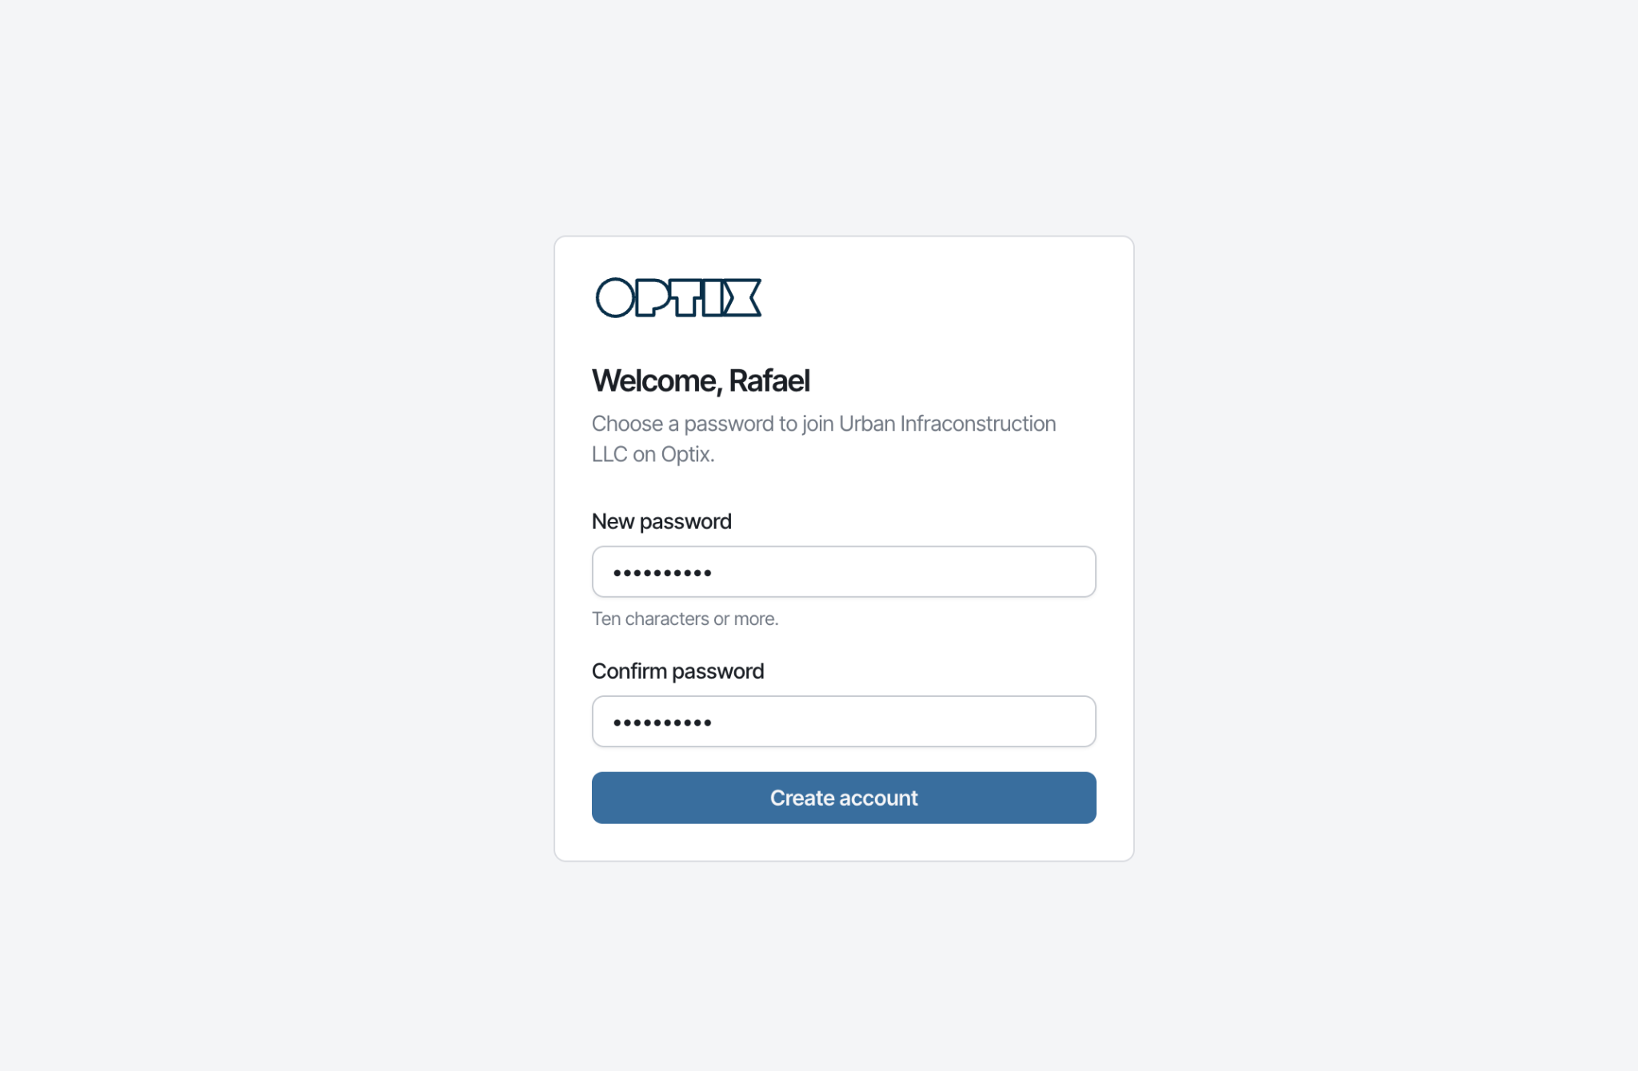
Onboarding
Bodhi Labs · Optix Small Tools Inventory
Getting Started

Slide 5
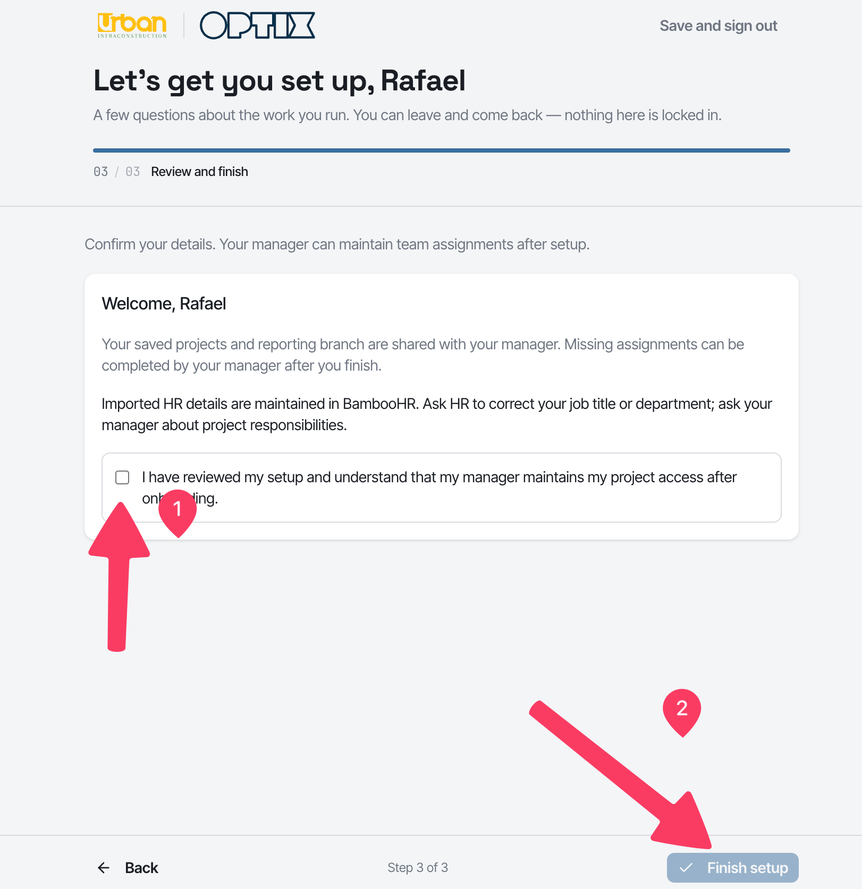
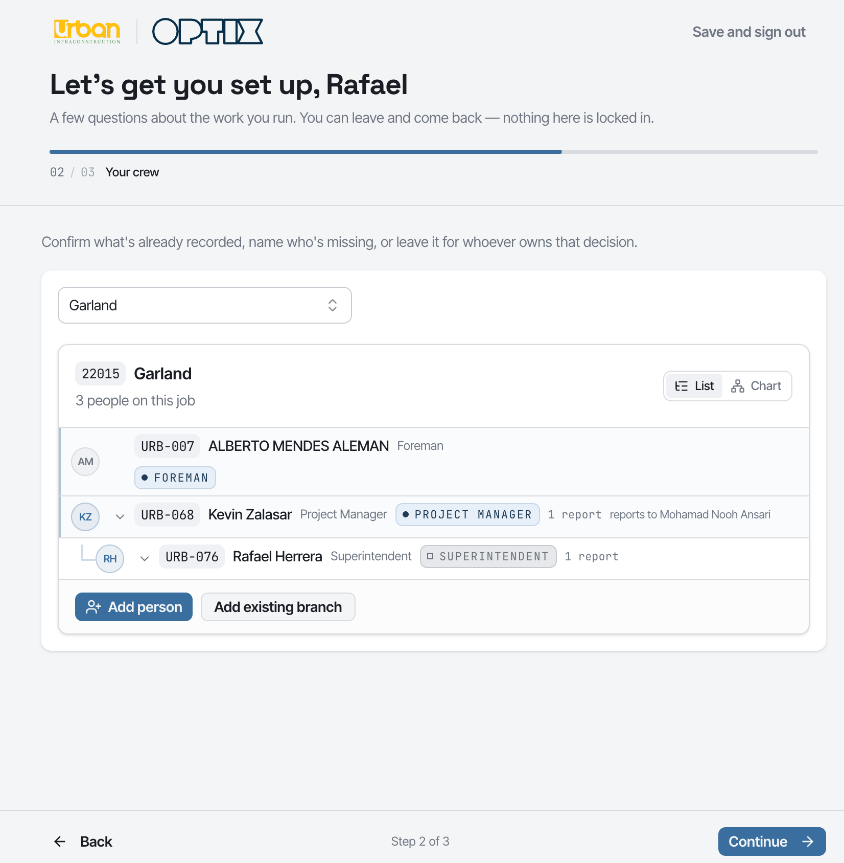

Slide 6
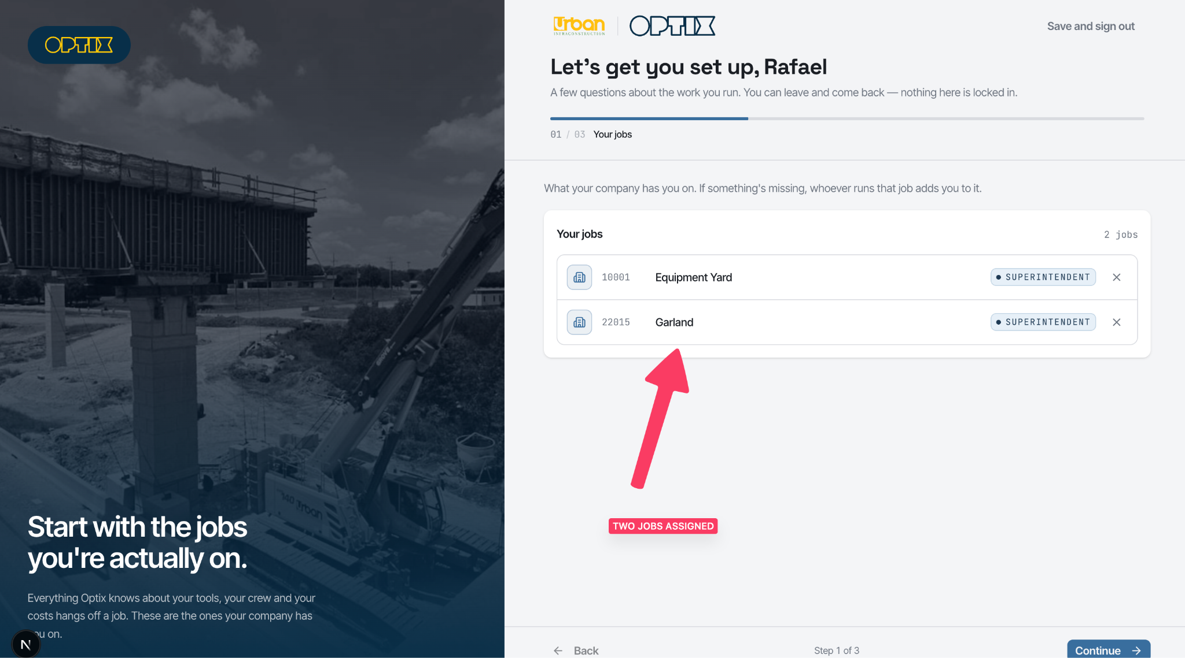

Slide 7
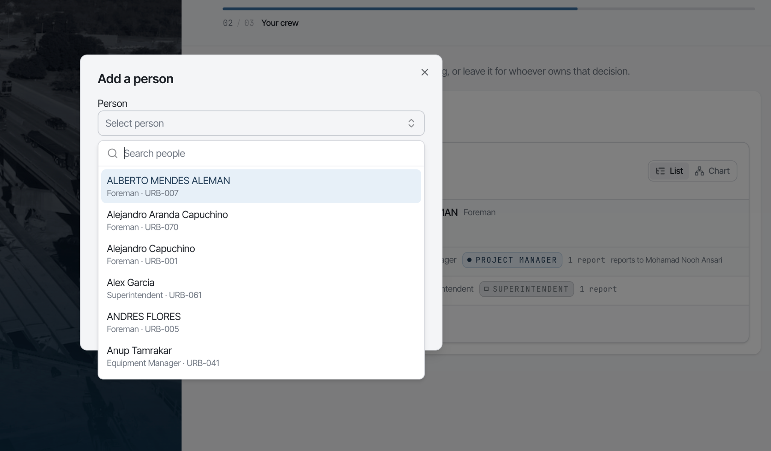

Slide 8
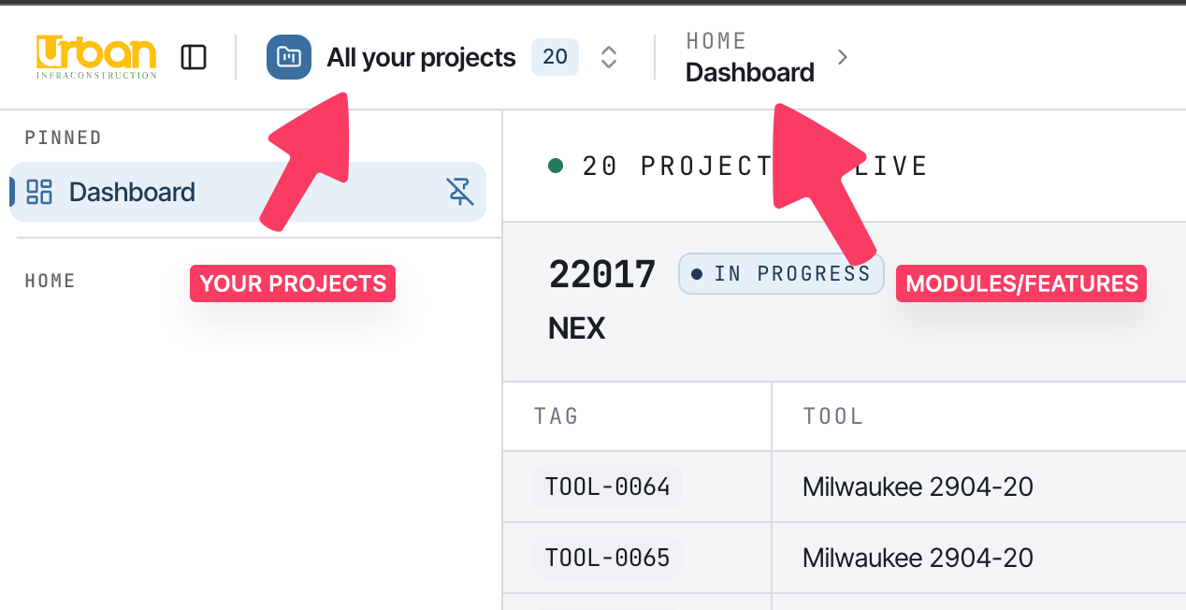
How Optix is laid out
Bodhi Labs · Optix Small Tools Inventory
Getting Started

Slide 9
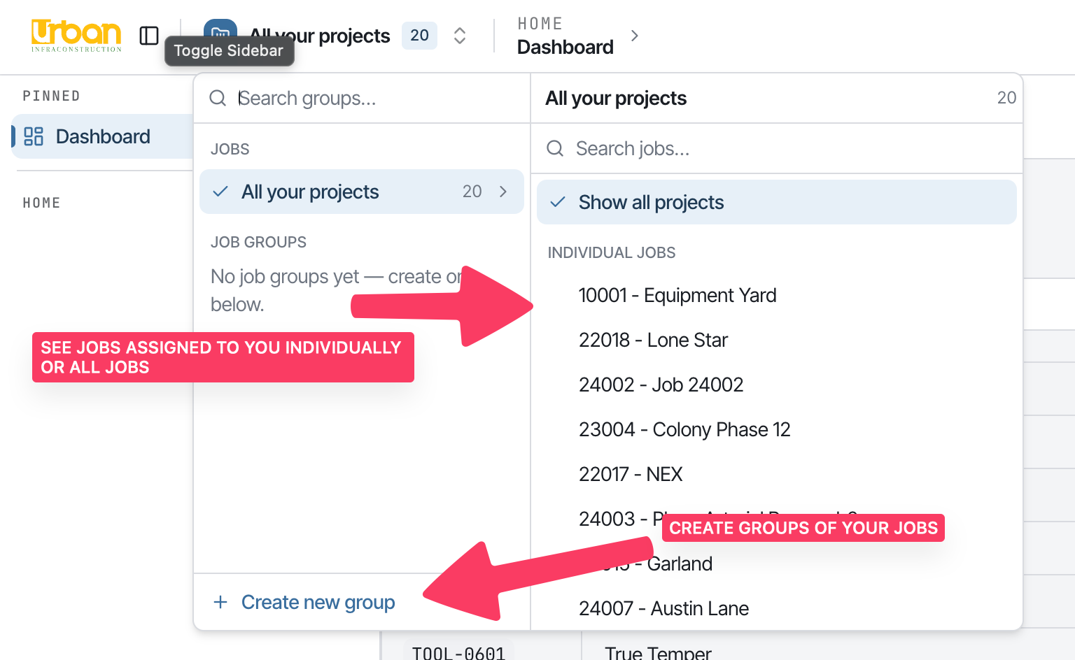
How Optix is laid out
See one job, all jobs, or a group you create
You can be assigned to several jobs. Every screen can be read for a single job, for all of them, or for a group you save.
Bodhi Labs · Optix Small Tools Inventory
Getting Started

Slide 10
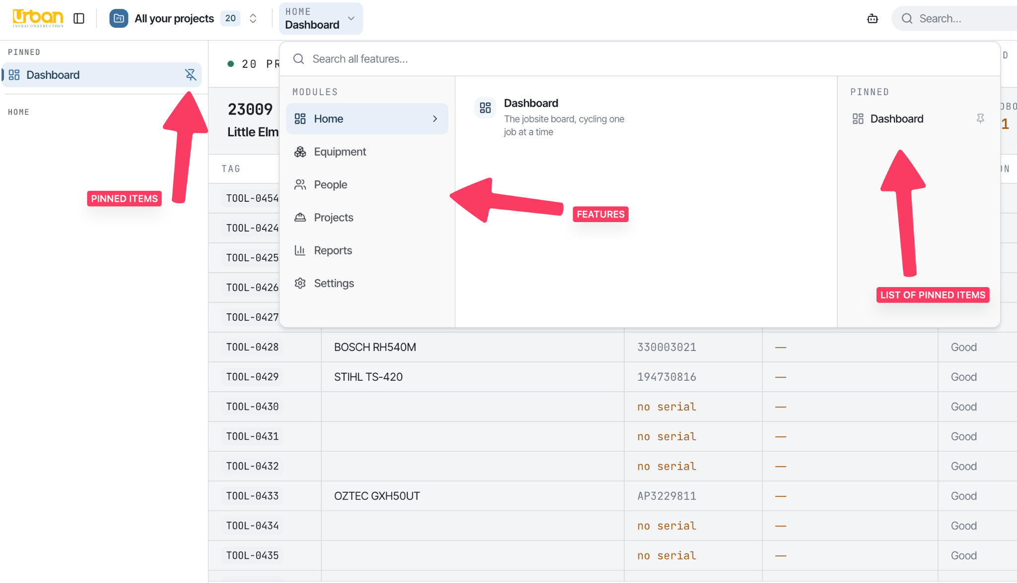
How Optix is laid out
Bodhi Labs · Optix Small Tools Inventory
Getting Started

Slide 11
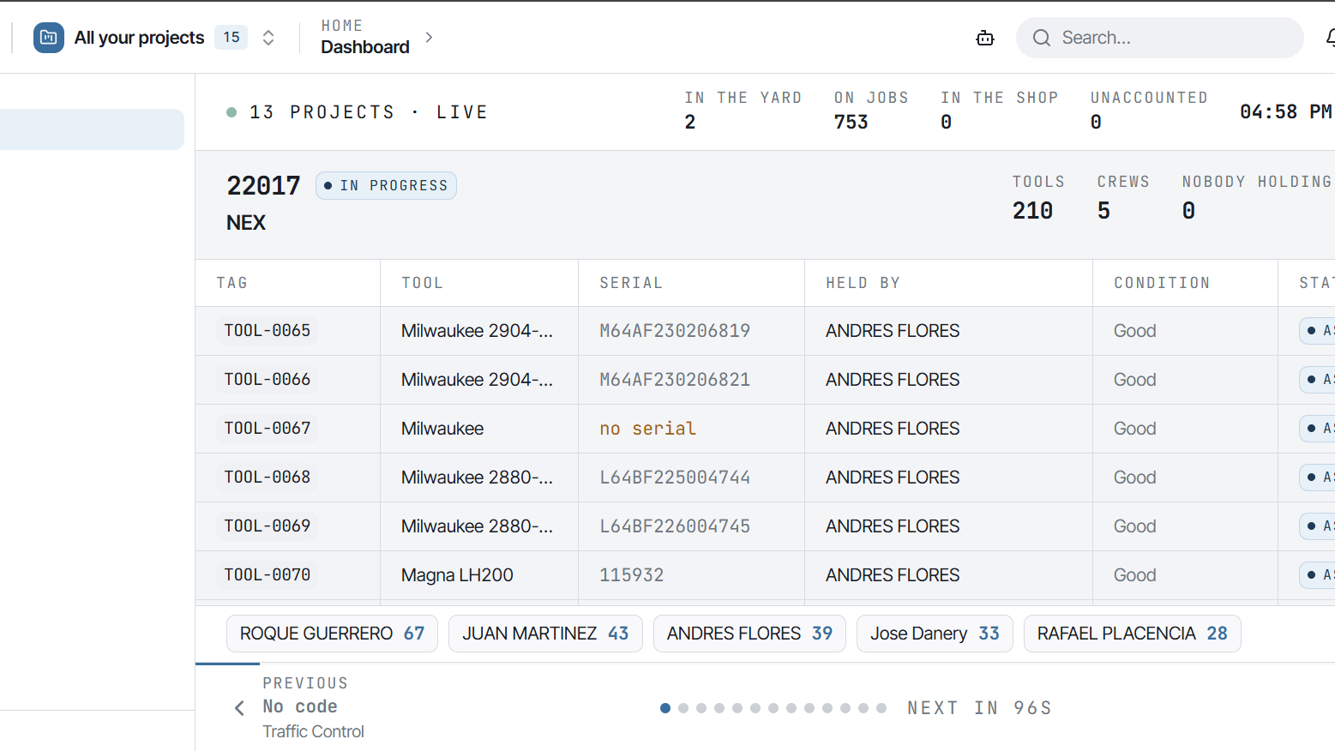

Slide 12
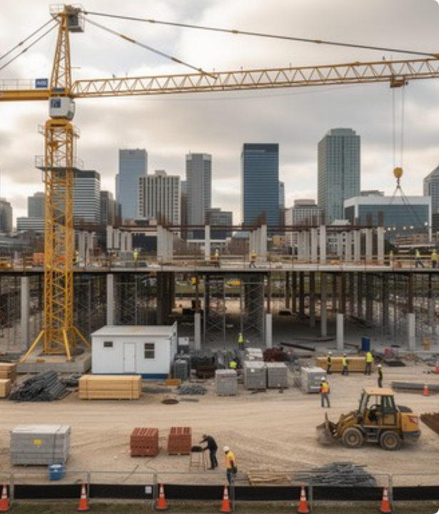
VISION: ONE TOOL. ONE TRUTH.
Connected Field Intelligence
Optix connects yard equipment desks, field managers, and site crews through a single unified digital network.
Centralized Identity: every tool carries a unique ID linked to its specs and its current holder.
Live Custody Chain: every hand-off is recorded as it happens — the register is folded from that chain.
One System of Record: the ledger is the truth; every screen is a projection of it.

Slide 13

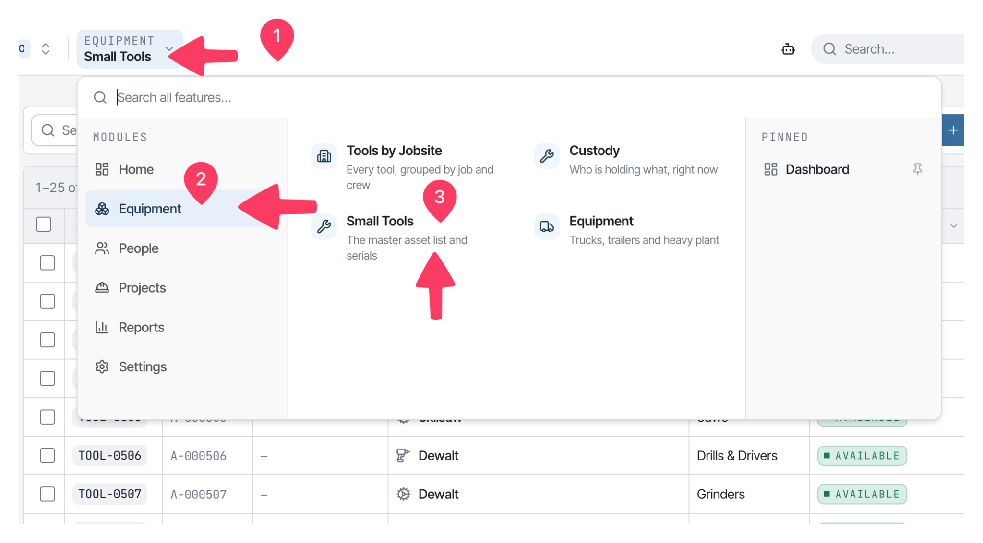
Small Tools Register
Centralized Asset Identity
Every small tool Urban owns, in one register, with make, model, serial and current holder.
Tag & reference: a searchable code per tool — optional until somebody labels it.
Categories that match the yard: Hand Tools, Saws, Drills, Grinders, Compaction, Power & Yard, Survey.
Current holder: who is holding it right now, read from custody, not typed in.
Global search: filter by make, serial, tag, category or jobsite.
Bodhi Labs · Optix Small Tools Inventory
Tool Register

Slide 14
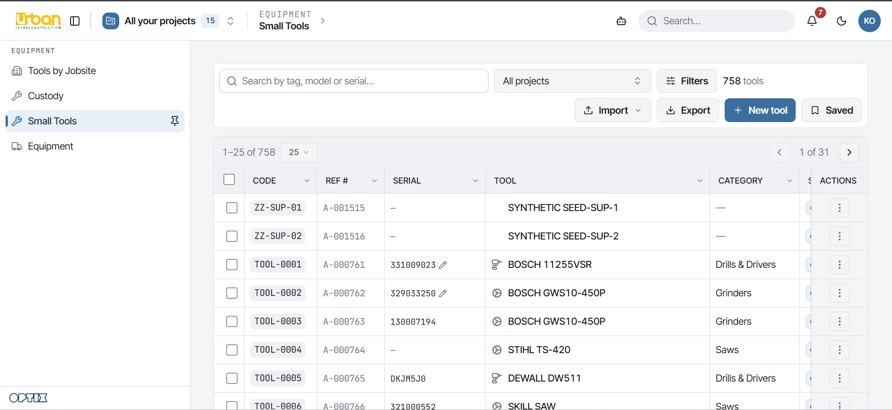

Slide 15


CUSTODY CHAIN ARCHITECTURE
Calculated from Unbroken Hand-Offs
Where a tool is located is never typed manually—it is mathematically derived from an unbroken chain of field custody records.
Ownership vs. Custody: Ownership (who paid) and custody (who currently holds it) are tracked separately.
Held Assets: Currently in active possession of a specific foreman, superintendent, or shop.
In transit: on its way between jobs or back to the yard, held as a status on the tool.
Awaiting approval: a high-value move parked for a second administrator's sign-off.

Slide 16
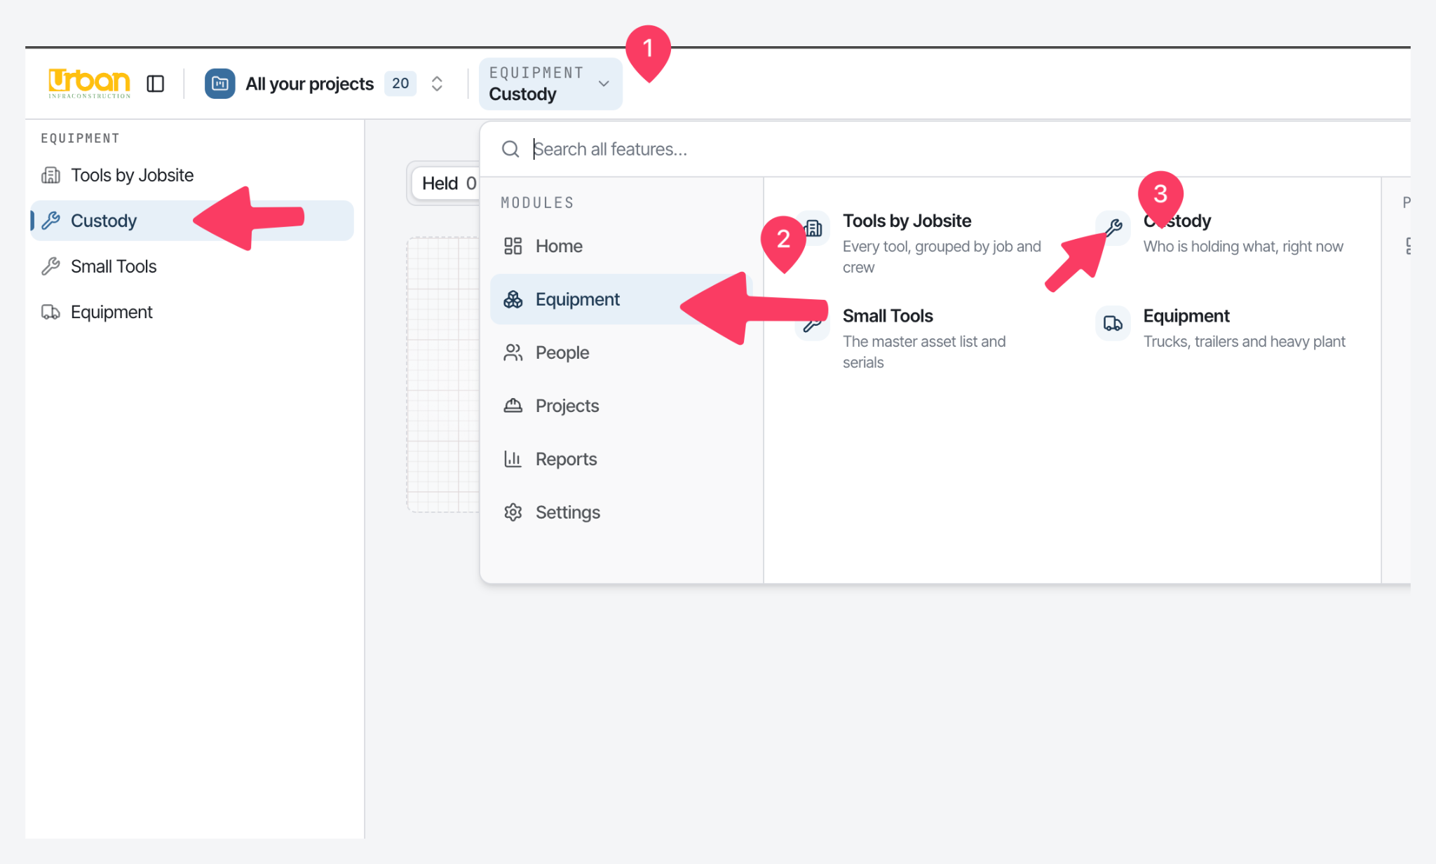

Slide 17
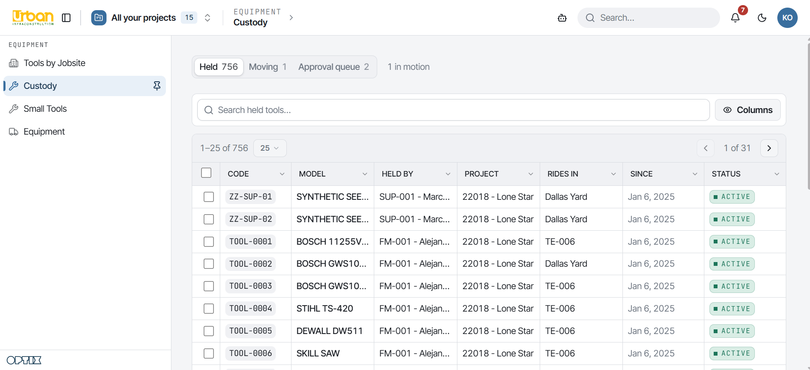

Slide 18




4-STAGE CUSTODY LIFECYCLE
Every Movement Is Recorded by the Desk — Nothing Moves Without a Ledger Entry
1. Tag & Register
2. Assign to a Custodian
3. Reassign
4. Yard Return
New tool enters the register; a tool ID is created.
Issued by the equipment desk and charged to a project.
The desk moves custody; a high-value tool needs a second approver.
Cleared back to the desk, or reassigned straight to another job.
Control: only the equipment desk moves tools — a foreman reports, never reassigns. High-value moves park for a second administrator's approval.

Slide 19




IMMUTABLE CUSTODY AUDIT LOG
Complete Activity History Recorded for Compliance and Loss Verification
Timestamped Field Events
Full Context & Compliance
Exact date, minute, and location automatically captured for every custody status update. Correcting a mistake logs a correction event rather than deleting history.
Explicitly reveals previous holder, new holder, job site ID, and timestamp. Built specifically to support internal audits and insurance loss verifications.
Audit Trail Sample Record:
[2026-09-11 14:22:05] transfer | Asset: UIC-1008 | From: Equipment Yard | To: Foreman J. Miller | Job: 22017 NEX | Actor: Equipment Desk

Slide 20
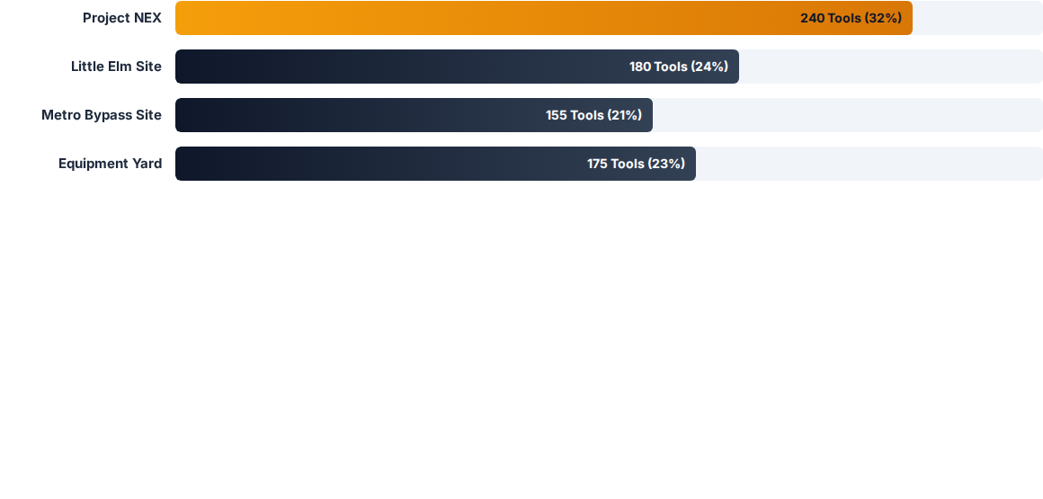


TOOLS BY JOBSITE & CREW BREAKDOWN
Crew Attribution
Hierarchy Drill-Down
Maps tools directly to specific foremen and their immediate crew for total site accountability.
Leadership can drill down from Project Manager level to individual tool serial numbers instantly.

Slide 21
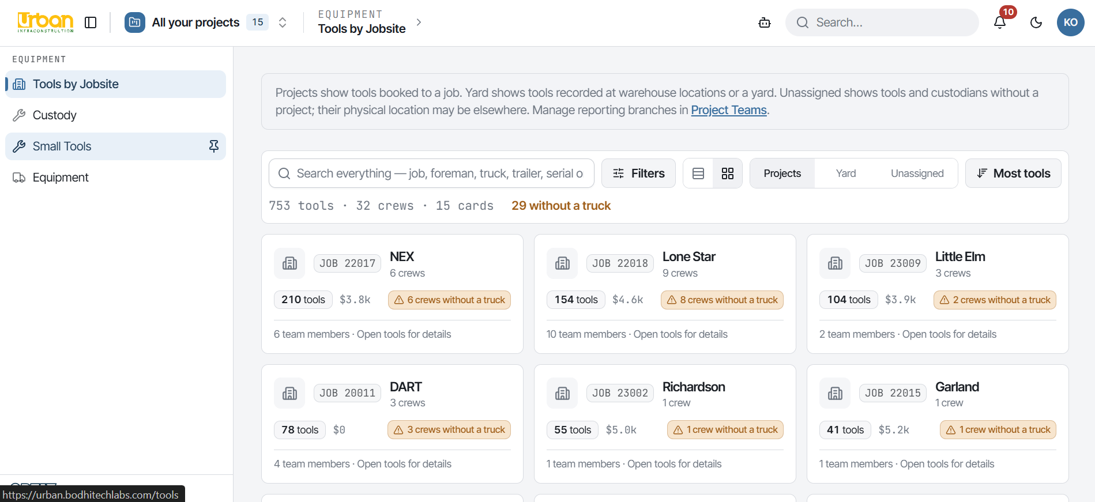

Slide 22










REPORTS, ANALYTICS & LOGS
13 Built-In Reports and Logs for Operational & Financial Fleet Intelligence
Asset Register
Assets by Project
Idle Assets
Capital by Project
Every tool the company owns, with who holds it, where it is, and which project paid for it.
What each job is holding right now — operational custody, not who was billed.
Available and sitting. Check this before approving a purchase for something already owned.
Financial ownership — what each project actually paid for, wherever the tool sits today.

Slide 23
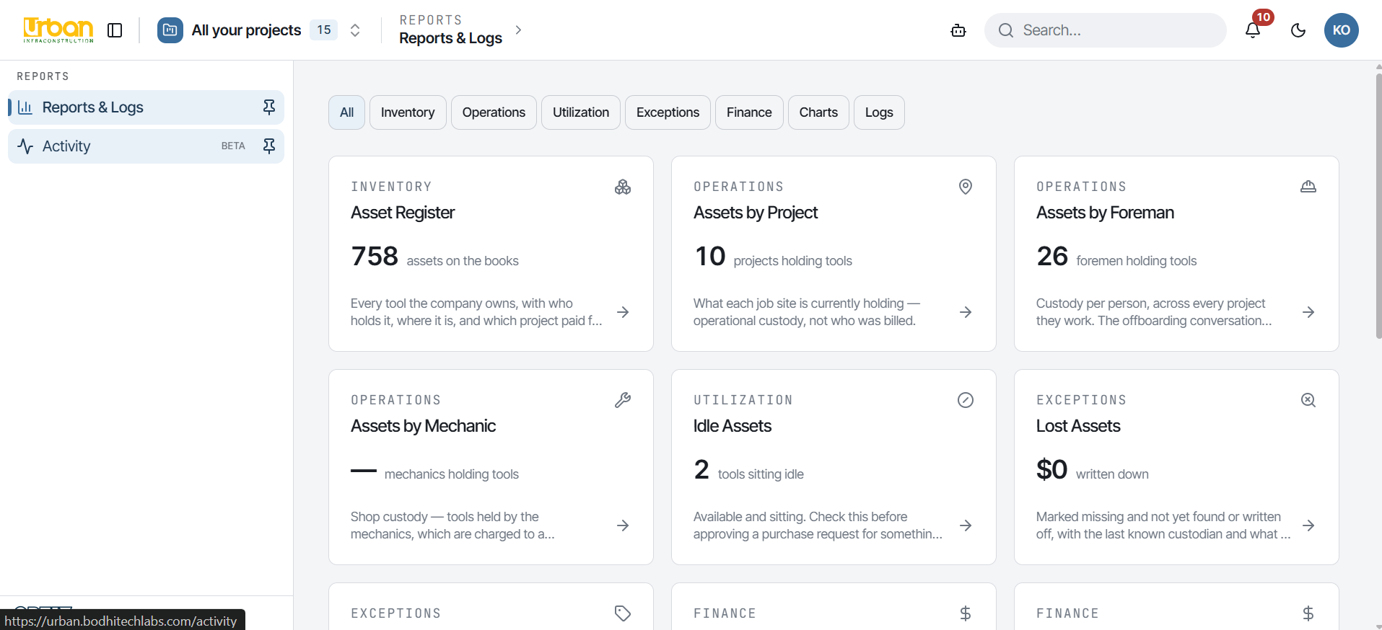

Slide 24
ROLE-BASED ACCESS CONTROL
One access model, three axes — and only one of them needs to appear on screen.
Equipment Desk: owns yard inventory. Issues and receives tools, approves high-value moves, clears departing workers.
Field Foreman: a phone-first surface — what he holds, and one sentence to the desk to report or request.
Project Manager: sees the tools on their own jobs and staffs the job's crew. Does not move custody.
Mechanic & Shop: holds shop tools charged to the Repair & Maintenance department.
Superintendent: runs several crews; approves assignments and transfers inside their crew scope.

Slide 25
HOW ACCESS ACTUALLY WORKS
Three separate axes describe a person. Only one of them belongs on screen.
HR job title: what payroll calls the post. Decides which login role a synced person arrives with.
The same person can be a Carpenter, hold no account, and be a Foreman on this job — all three at once.
Login role: what an account may see and do, set in Settings → Access Roles.
On screen: one word per person — the word they would use for themselves.
Job tier: where somebody sits on ONE project — foreman, superintendent, PM. Per project, never from a title.
Notes:
The three axes are employment/HR title (company_role), login role (role), and job tier (team_role). Members of the audience only ever need the tier. If someone asks why they 'have three roles', this slide is the answer: the system is precise, the screen is deliberately simple.

Slide 26
TWO LAYOUTS: FIELD AND DESK
Give each person the surface their job needs — not the full app with two thirds greyed out.
Field layout
Desk layout
•
Built for a phone, standing in a yard: My Tools, Hand Off, Alerts, My Crew's Setup.
The equipment desk runs the operation: Tools by Jobsite, Custody, the registers, People, Crews and Projects.
•
A foreman sees only what he is holding; a superintendent sees his foremen's tools too.
Reports and the audit trail live here — the strongest surface in the product, gated per role.
•
No registers, no settings, no navigation to learn — three things the job actually needs.
Notes:
The layout is chosen by the role's uses_field_layout flag, which is editable in Access Roles — it is a layout decision, not access control. Every item in each layout is still permission-filtered separately.

Slide 27
ROLES & SCREENS — FULL AUTHORITY & THE OFFICE
Four roles that hold the widest grants — and where the deliberate limits are.
Owner / Tech Admin
Equipment Admin
Office Admin
Warehouse
All 35 permissions. Configures the tenant. Owner is Urban's; Tech Admin is Optix's own operator.
Full equipment authority: the register, custody, and who holds what.
People, accounts and projects. No custody at all — deliberately.
The yard desk: issues, receives and reassigns tools. The role that routinely moves custody.
Notes:
Owner and Tech Admin hold every permission. Office Admin is the deliberate split: it runs people and projects but cannot touch custody.

Slide 28
ROLES & SCREENS — LEADERSHIP
The tier ladder: authority is per job, and travels down the chain.
Director
Area In-charge
General Superintendent
Project Manager
Claims the jobs they run, then staffs them. Places area in-charge and general superintendents.
Runs an area: places PMs and superintendents on the jobs they claim, and can itself claim.
Runs an area's superintendents and may hold tools. Staffs PMs and superintendents.
Sees tools on their own jobs; staffs the job's foremen and engineers. No custody.
Notes:
This is the tier ladder. Authority is per job: a superintendent with power on Job A has none on Job B. Nobody can place a Director — a Director joins a job by claiming it.

Slide 29
ROLES & SCREENS — FIELD & SPECIALIST
The narrowest grants — and the roles a live rollout depends on.
Superintendent
Foreman
Mechanic
HR · Finance · Procurement · Read-only
Field layout. Approves assignments and transfers; sees his foremen's tools as well as his own.
Field layout. Sees and reports what he holds. Cannot reassign — that is the equipment desk's job.
Field layout. Holds shop tools charged to Repair & Maintenance. No crew screens.
Office roles: people, reports and register reads — none of them move custody.
Notes:
Field roles get the three-item layout. Foreman and Mechanic cannot move custody by any route — UI, chat or a direct API call.

Slide 30
HOW TO DO IT: THE DAILY TASKS
Four moves cover almost all of the daily work — and every one writes to the same ledger.
Assign a tool
Hand over a container
Move a person to a job
Onboard a crew
Tools → row menu → Assign. Pick the custodian and a location.
Locations → Hand over. Contents move with it by default.
People → Move job. Their tools follow them to the new job.
Crews → claim the job, then place people tier by tier.
Take on a job: leadership claims a job first, then staffs it top-down through the tier ladder.
Notes:
These are the operations that cover nearly all day-to-day use. Assign, hand over and move-person all write ledger events; crew onboarding writes the roster that decides who can see what.

Slide 31






MEASURABLE BUSINESS OUTCOMES
100%
$0
1-Tap
Live
Digital Trail History
Duplicate Capex Spend
Offboard Reassignment
Executive Oversight
Zero Missing Tool Records
Instant Offboarding
Unbroken digital history from day one of purchase through field transfers and yard returns. No lost paper trail.
Reassign all inventory held by an exiting crew member in a single action, preventing tool leakage during turnover.

Slide 32

Thank You
Questions & Discussion
Bodhi Labs Pvt. Ltd.
urban.bodhitechlabs.com
Sankhamul, Kathmandu, Nepal
Bodhi Labs · Optix Small Tools Inventory
Q&A

